Slide 1
Ensemble Model: Random forest

Slide 2
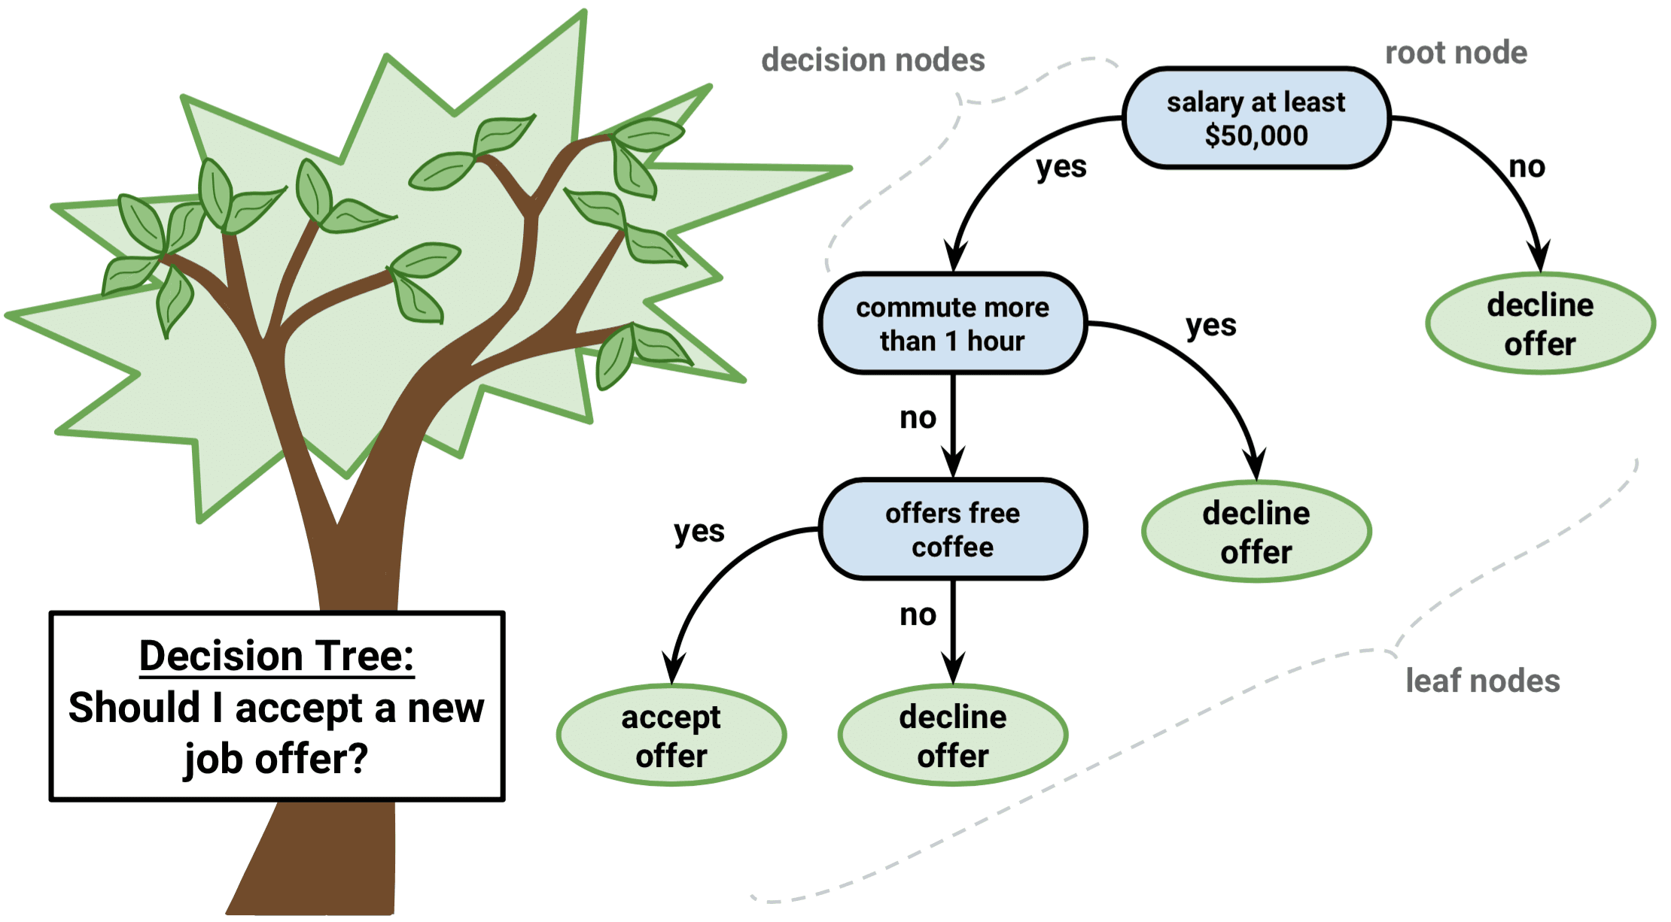
Limitations To Decision Trees
Decision trees tend to over fit on their training data.

Slide 3
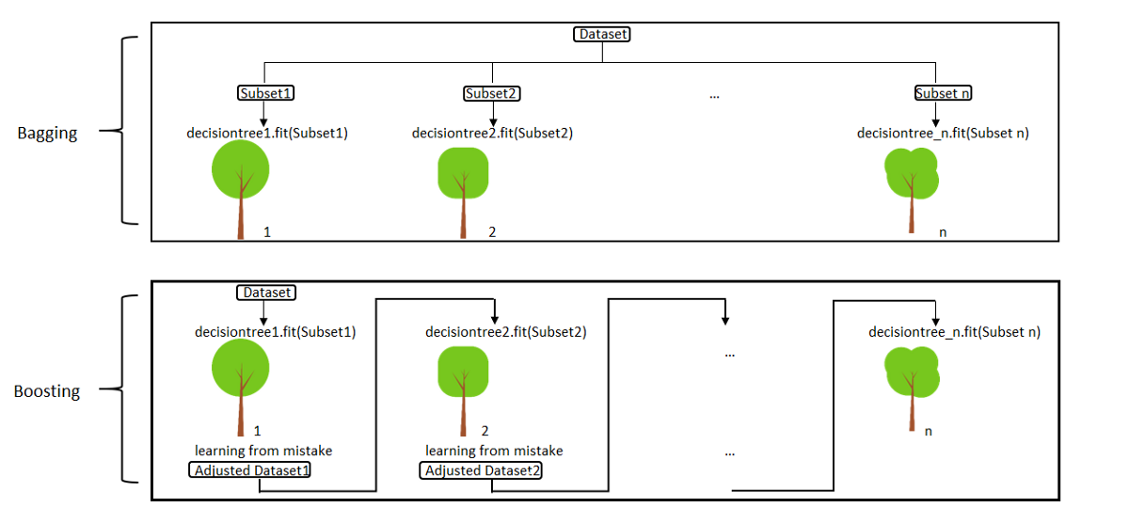
Ensemble Learning
Is a model that makes predictions based on a number of different models.
By combining individual models, the ensemble model tends to be more flexible
Two most popular ensemble methods are:
Bagging: Training a bunch of individual models in a parallel way.
Boosting: Training a bunch of individual models in a sequential way. Each individual model learns from mistakes made by the previous model.

Slide 4
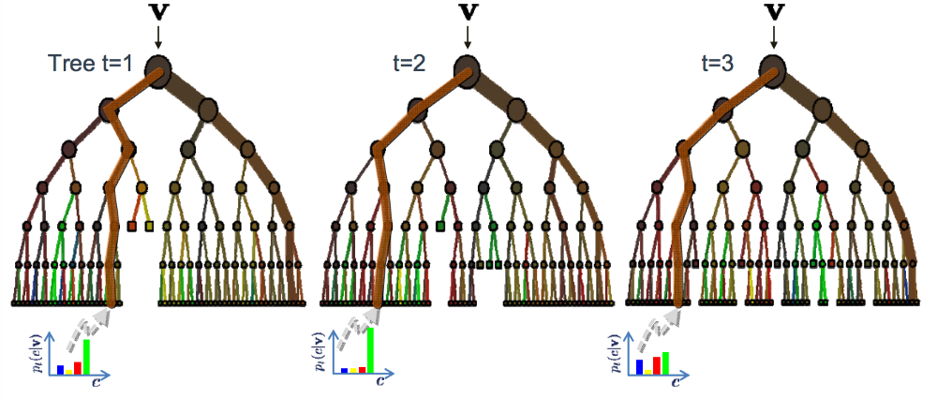
Ensemble Model

Slide 5
How it works
Random Forest is a supervised learning algorithm.
It creates a forest and makes it somehow random.
The “forest“ it builds, is an ensemble of Decision Trees, most of the time trained with the “bagging” method.
The general idea of the bagging method is that a combination of learning models increases the overall result.
Random forest builds multiple decision trees and merges them together to get a more accurate and stable prediction.

Slide 6
Real Life Analogy
Imagine Andrew wants to decide, to which places he should travel during his vacation trip.
He asks people for advice.
First, he goes to a friend and where he traveled to in the past and if he liked it or not. Based on the answers, Andrew can decide where he should visit.
This is a typical decision tree algorithm approach.

Slide 7
Real Life Analogy
Afterwards, Andrew starts asking more and more of his friends to advise him.
Then he chooses the places that were recommend the most to him
It is typical Random Forest algorithm approach.

Slide 8
Building A Random Forest
Choose the number of trees you’d like in your forest (M)
Choose the number of samples you’d like for each tree (n)
Choose the number of features you’d like in each tree (f)
For each tree in M:
Select n samples from all observations
Select f features at random
Train a decision tree using the data set of n samples with f features
Save the decision tree

Slide 9
How A Random Forest Makes A Prediction
Given an observation (o).
For each tree (t) in the model:
predict the outcome (p) using the tree (t) applied to observation(o)
store predicted value (p) in list P
If the model is a classifier:
return max_count(p)
If the model is a regressor:
return avg(p)

Slide 11
Thanks

